Slide 1
0x107 – Internet of Things
ECED4406 – Computer Security
Dr. Colin O’Flynn
Dalhousie University.

Slide 2
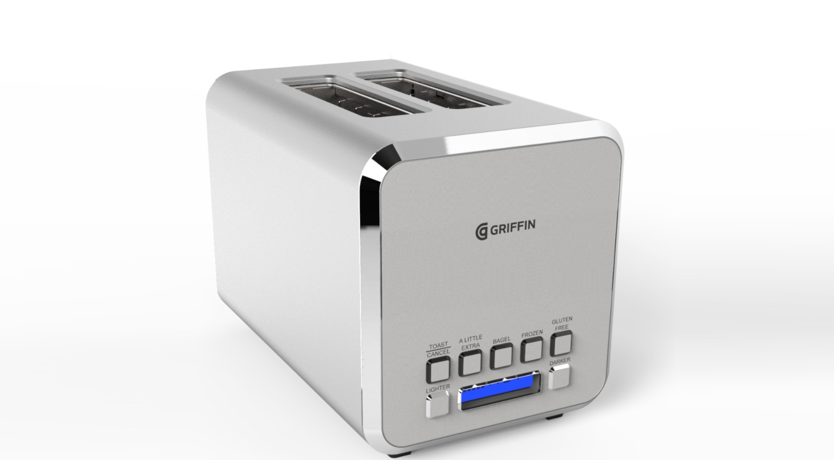

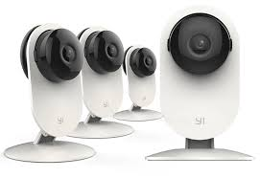

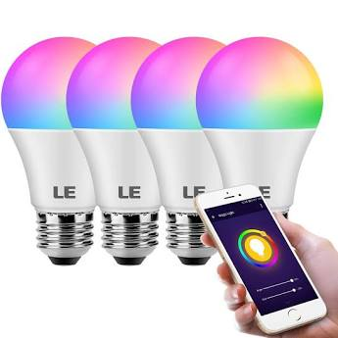
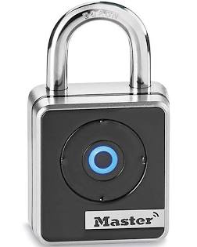
What is the Internet of Things?

Slide 3
Internet of Things Considerations:
Products are highly cost driven.
Security requirements only recently introduced.
Products designed to be usable by consumers easily.
Products often have short (<5 year) lifespan.

Slide 4
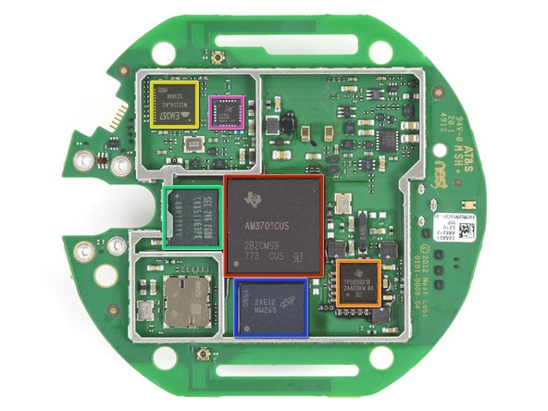
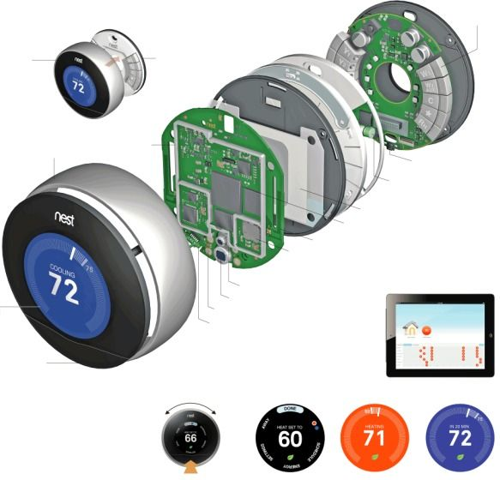
Internet of Things – Linux or Android Based
Full-blown OS
Most interesting from attack perspective → can run lots of applications on the device.

Slide 5
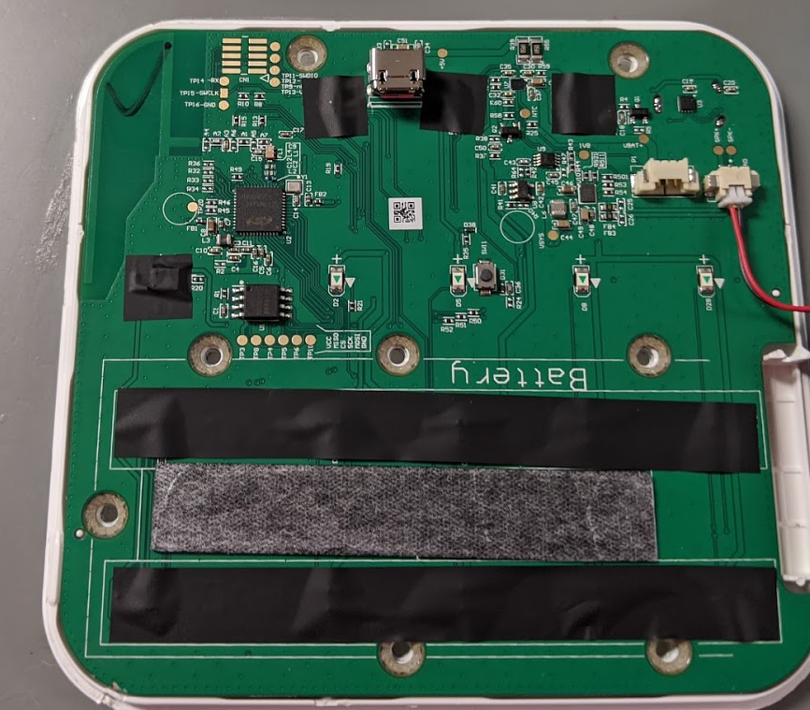
Internet of Things – Custom Embedded
Either no operating system or rea-time operating system.
Very low-power devices.
Typically less security, but harder to exploit (resources more limited, cannot just run ‘anything’).

Slide 6
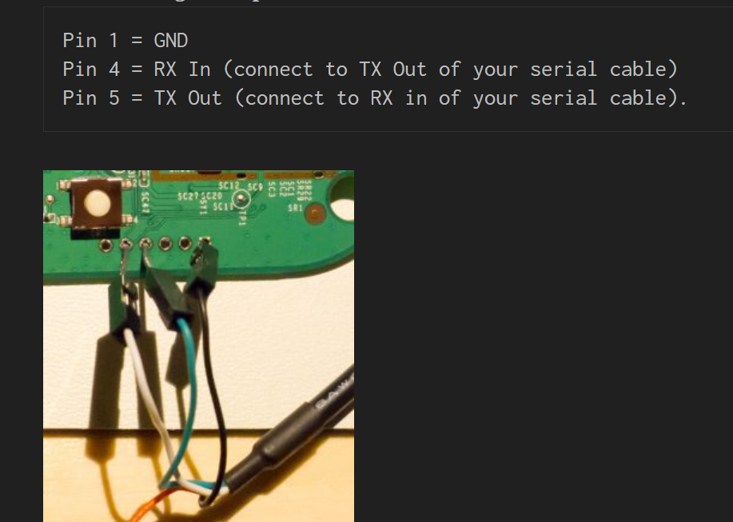
Simple Attack Vectors on Embedded OS
Serial port available
Serial port might give you a “console”
Console → Linux command prompt.
https://www.youtube.com/watch?v=hi2D2MnwiGM

Slide 7
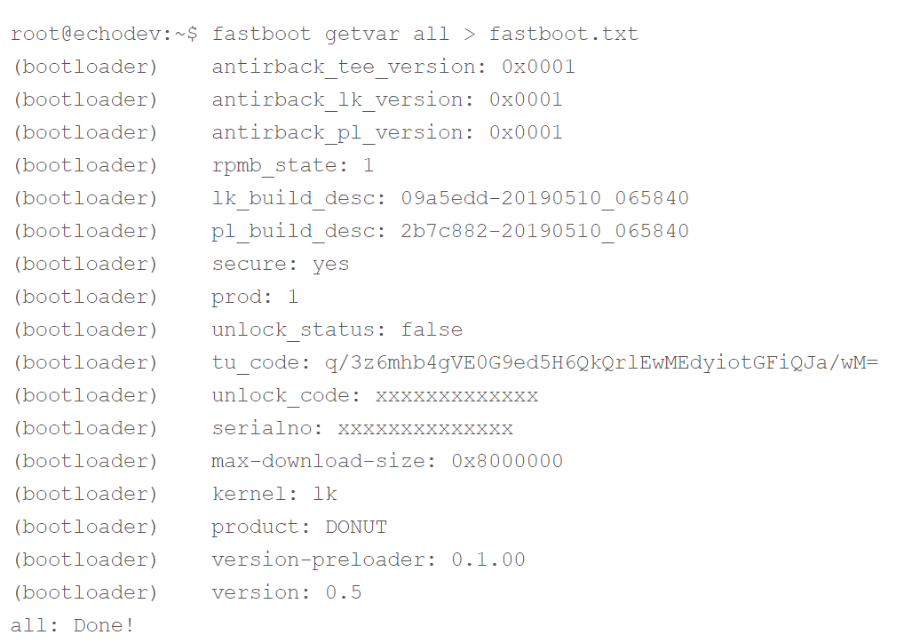
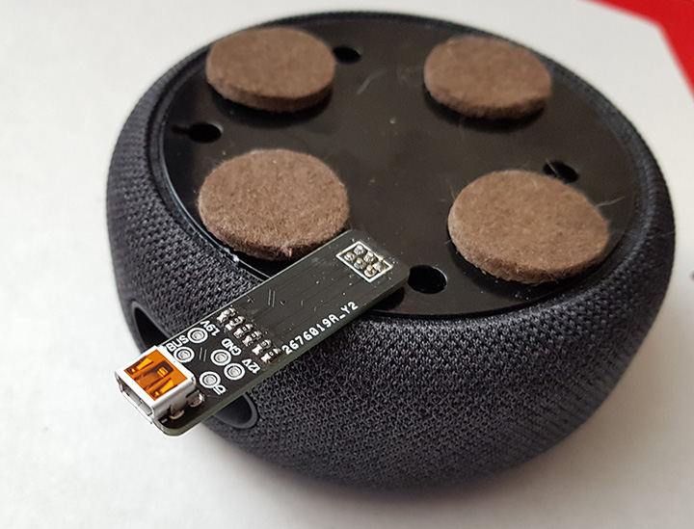
Simple Attack Vectors on Embedded OS
Android devices use a USB bootloader (‘fastboot’) normally.
Many android-based devices have a way to enable this USB bootloader.
https://www.briandorey.com/post/echo-dot-3rd-gen-digging-deeper

Slide 8
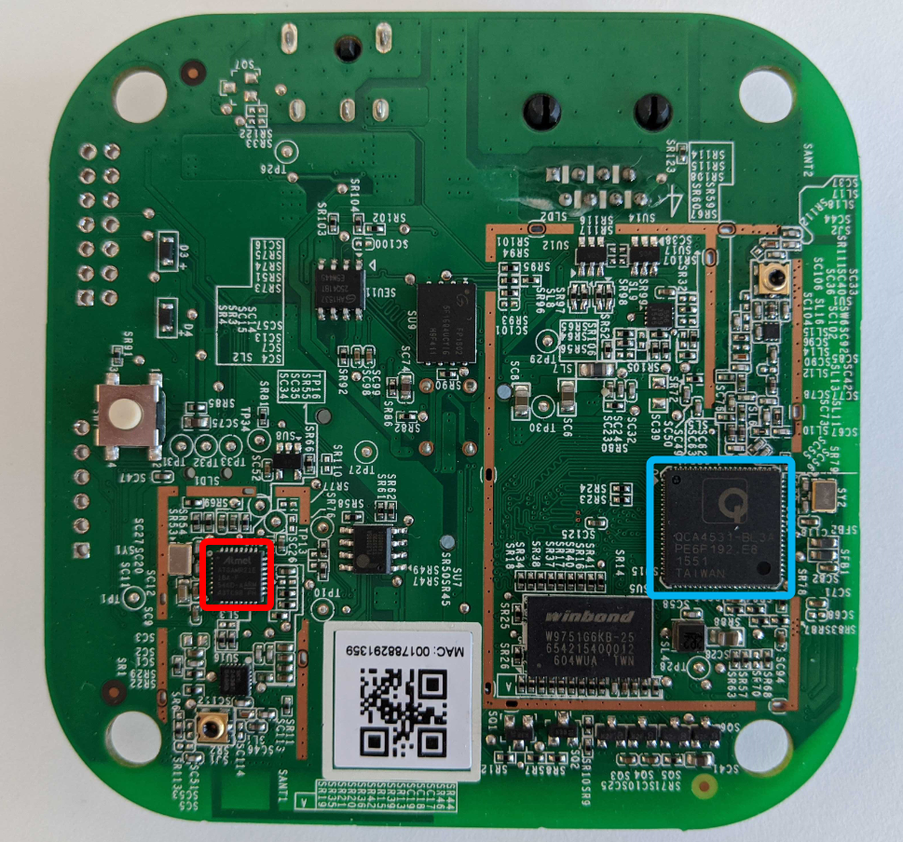
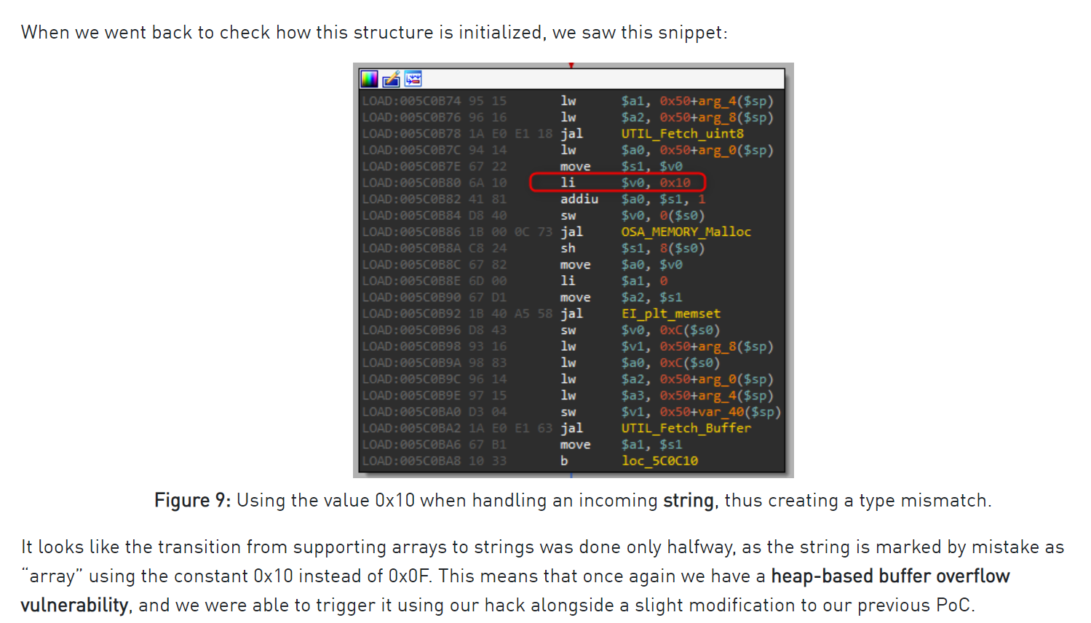
More Complex Attack Vectors on Embedded OS
Very complex attack vector – uses reverse engineering to find specific flaw, topics we’ll discuss in later sections of the class…
https://research.checkpoint.com/2020/dont-be-silly-its-only-a-lightbulb/

Slide 9
Embedded OS vs. RTOS/Bare-Metal
Embedded OS devices have a wide range of possible vectors, many overlap with classic ‘computer security’, such as:
What services are running?
Are there flaws in the processes?
Is there some “master binary”?
RTOS or “Bare-Metal” devices (bare-metal means running without any operating system):
Likely system has fewer interfaces.
System may not be as extensively tested.

Slide 10
Class Contents for IoT
Class won’t cover topics such as embedded Linux systems.
We’ll be covering reverse engineering & low-level attacks relevant mostly to ‘bare metal’ and ‘RTOS’ type systems.
The fundamental operations also apply to Linux or Android based systems, but are not the main topic we’ll cover here.

